Slide 1
Performance evaluation of Breast Cancer diagnosis using various Machine learning algorithms

Slide 2
TEAM MEMBERS
Bharti Ghildiyal
Diksha Gupta
Km Purnima
Dr Sangeeta Arora(Project Supervisor)

Slide 3
INTRODUCTION
This project aims to assess the performance of different machine learning algorithms in diagnosing Breast Cancer. By analyzing a comprehensive dataset, various algorithms will be applied and evaluated based on their accuracy, precision, recall, and F1-score. The study seeks to identify the most effective algorithm for early detection and accurate classification of breast cancer cases. The findings will contribute to improving the efficiency and reliability of breast cancer diagnosis, ultimately leading to better patient outcomes.

Slide 4
SOFTWARE REQUIREMENTS
Anacoda with Python3
Jupyter Notebook
Library used:- NumPy, Pandas, SkLearn
Framework:- Flask
Operating System:- Windows 10

Slide 5
HARDWARE REQUIREMENTS
Processor:- i3 or Above
RAM:- 4GB or Above
Hard Disk:- 500GB or Above

Slide 6
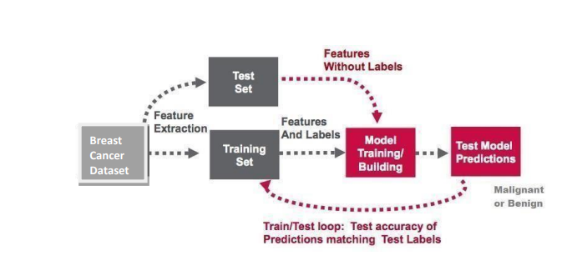
Working Flow

Slide 7
METHODOLOGY FOLLOWED:
Collection of dataset.
Understanding features of dataset.
Pre-processing the data.
Split data into training dataset and testing dataset.
Apply ML algorithm to dataset to predict the breast cancer.
Improving results.

Slide 8
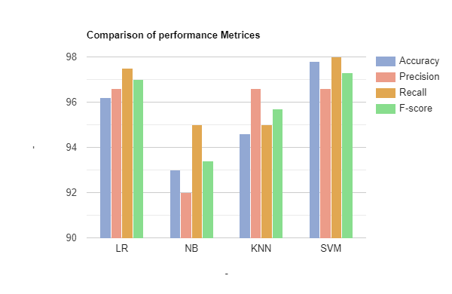

Slide 9
OUTPUT
The output of this project is to correctly check ad predict
whether a patient has breast cancer or not. If yes, the model
should also be able to tell if the patient has malignant or
benign type of cancer.

Slide 10
CONCLUSION
In conclusion, this study examined the performance of multiple machine learning
algorithms for breast cancer diagnosis. Results demonstrated that Support Vector
Machine(SVM) with the highest accuracy(97.8%), precision(96.6%), recall(98%), and
F1-score(97.2%).
Its implementation holds significant potential for early detection and accurate
classification of breast cancer cases. Byleveraging machine learning techniques,
healthcare providers can enhance the efficiency and reliability of breast cancer
diagnosis, ultimately improving patient outcomes and survival rates.

Slide 11
HOW TO SERVE SOCIETY
In India, the incidence of cancer is increasing rapidly; therefore it is important to step up
cancer literacy and knowledge amongst the population. We hope that this will lead to early
detection which is important in the management and treatment of cancer and also prevention
by making necessary changes in lifestyle.
Breast Cancer is rapidly rising amongst women in urban areas and it is the most common
cancer in India. Early detection is essential in its management and treatment. Due to ignorance,
fear, and social stigma many women present with stage III or IV cancer which requires surgery
and extensive treatment.

Slide 12
THANK YOU...

